Slide 1
ANDROID PROCESS MANAGEMENT
Name - Mohammad Rahber-E-Alam Raafa
ID - 1210953042

Slide 2
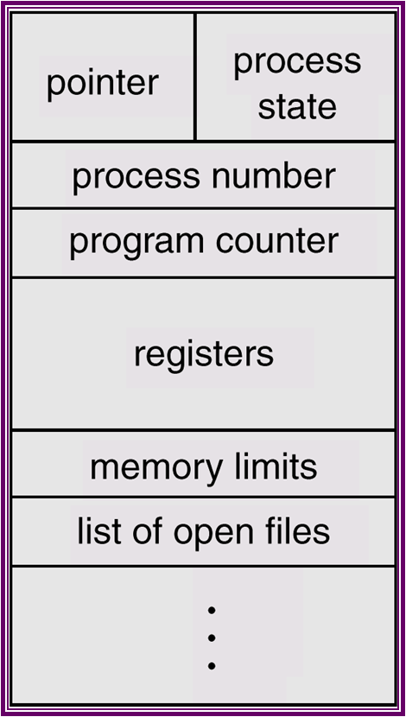
PROCESS CONTROL BLOCK

Slide 3
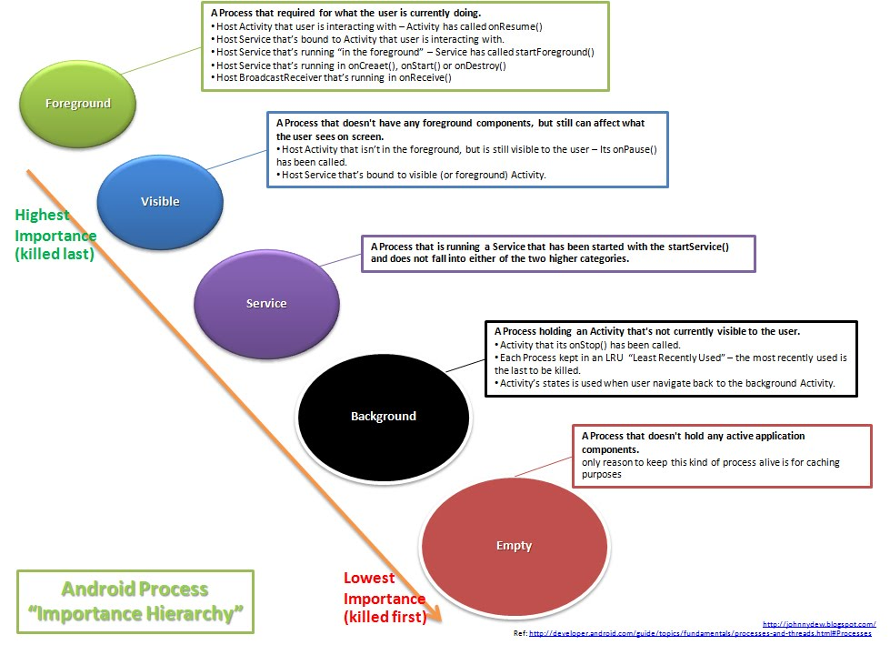
PROCESS HIERARCHY

Slide 4
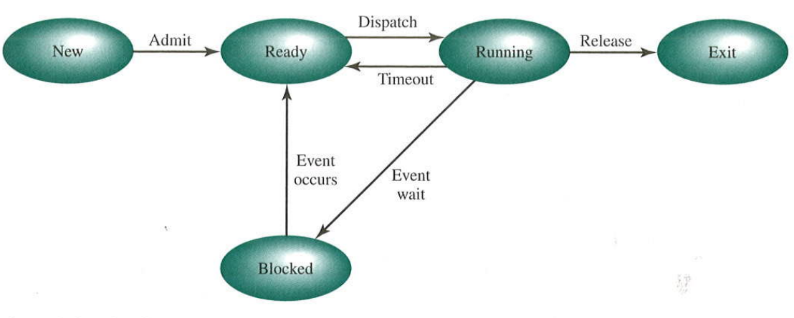
5 STATE PROCESS MANAGEMENT

Slide 5
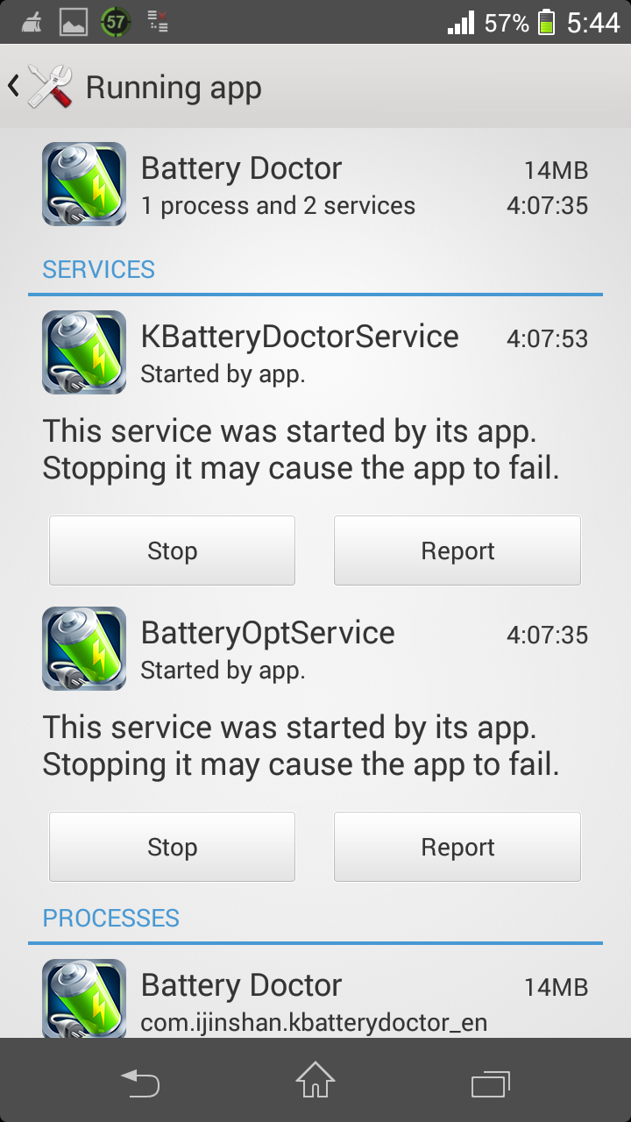
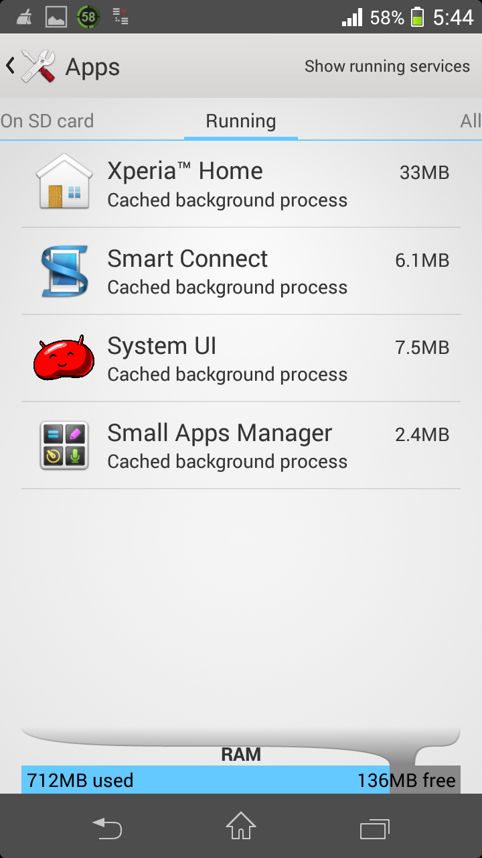
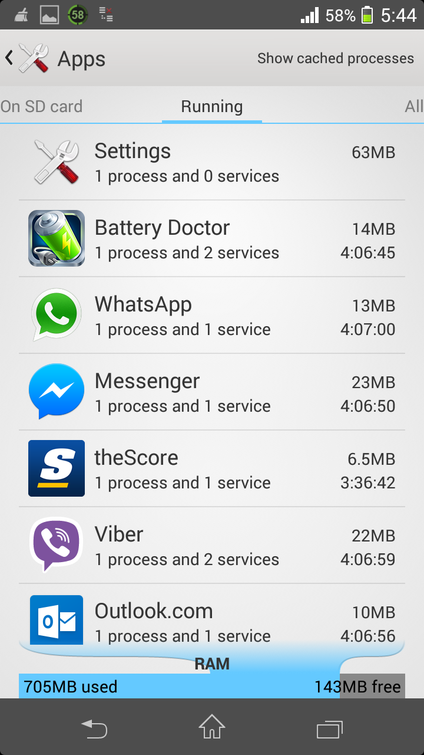
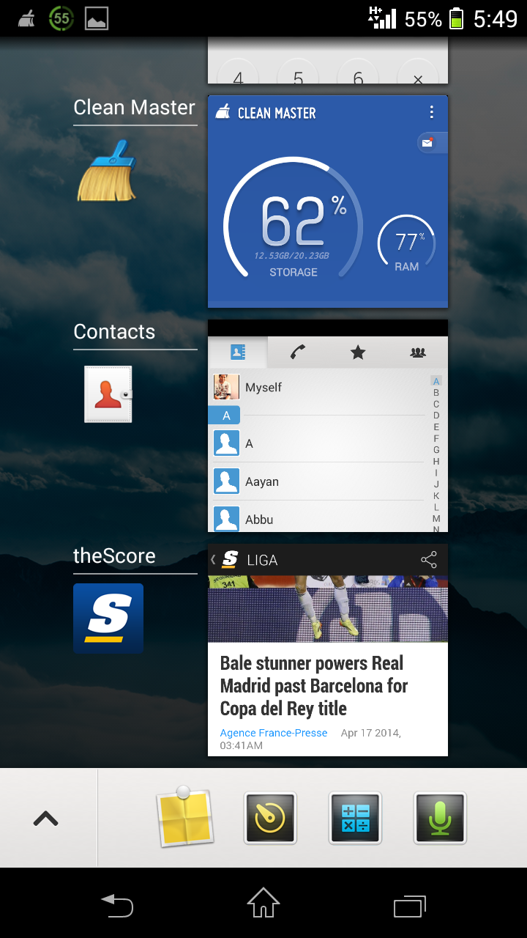
ITS UP TO YOU AS WELL!

Slide 6
WHAT MAKES ANDROID STAND OUT?
The Android OS is designed as a single user OS, so Android takes advantage of this and runs each component as a separate user.
The designers assign each application a unique UID at install time. This means the underlying Linux kernel can protect each applications files and memory without additional effort.
There is no single entry point for android applications. An application is a collection of components that can be used in other applications if desired.
The actual startup of a process differs from a typical operating system by using an existing process called the “zygote”, which is at the most basic level a "warmed-up" virtual machine. When you start an application, the Zygote is forked, so now there are 2 VMs. The real speedup is achieved by NOT copying the shared libraries. This means that all of the core libraries can exist in a single place because they are read only.

Slide 7
Thankyou

